Slide 1
Strucutural Analysis of Biofilms of Borrelia burgdorferi
Lyme Disease Research Group
University of New Haven
Eva Sapi PhD, Director
University Research Scholar
Associate Professor
Departments of Biology and Environmental Science

Slide 2
Research using
Cytoviva
Is respectfully
Submitted
By
University of New Haven
Borreliosis research Group

Slide 3
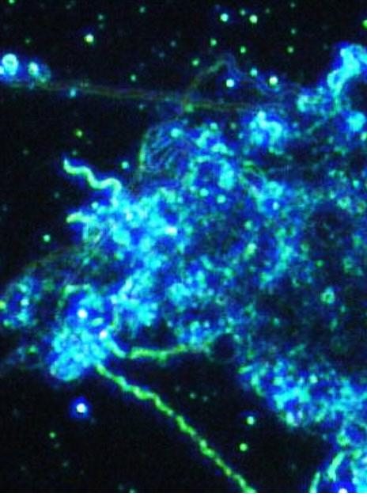
Biofilm
Community
Of Borrelia
Burgdorferi
Strain B31
Atcc 35210

Slide 4
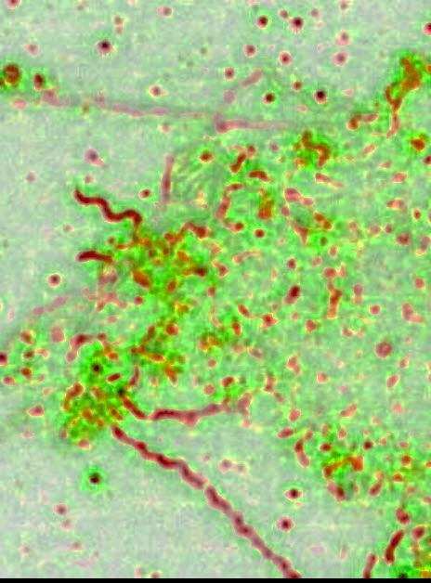

Slide 6
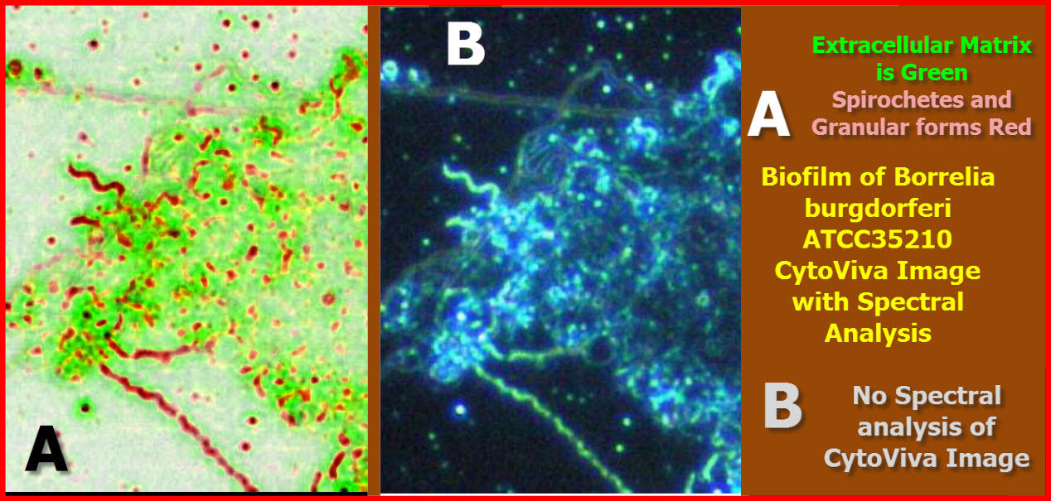

Slide 7
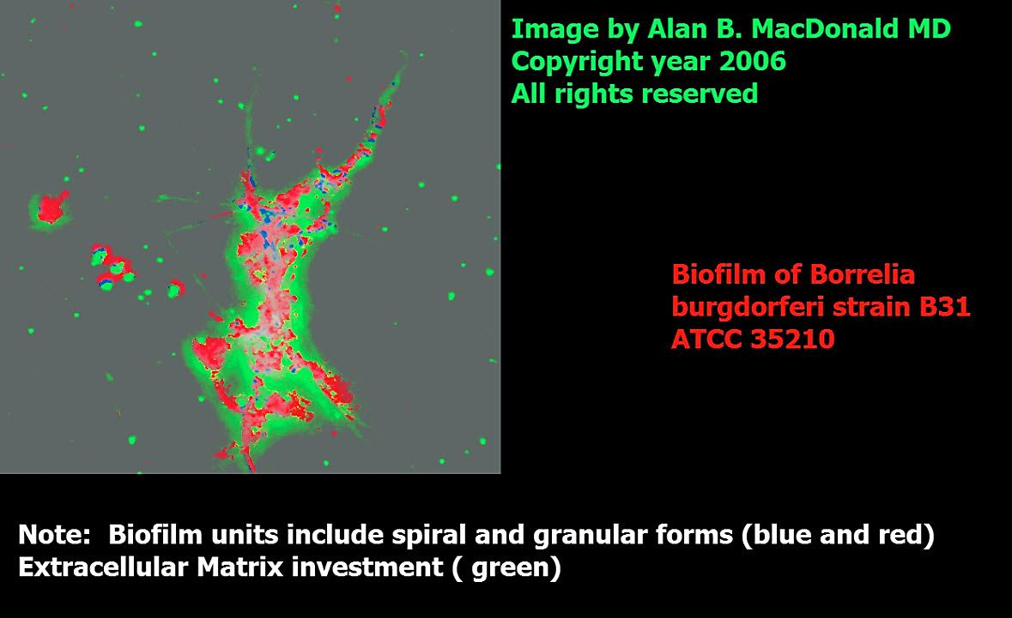

Slide 8
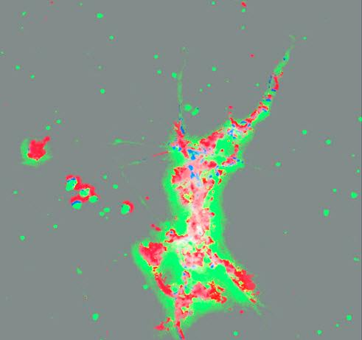

Slide 10
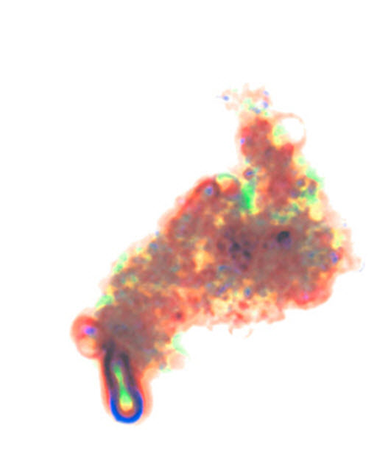

Slide 12
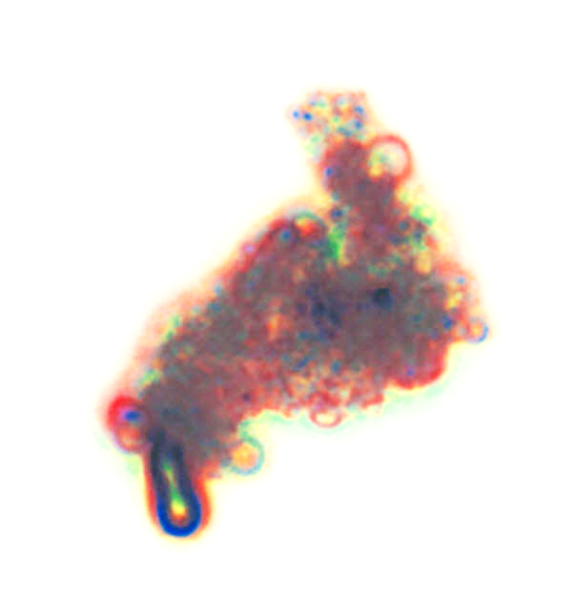

Slide 13
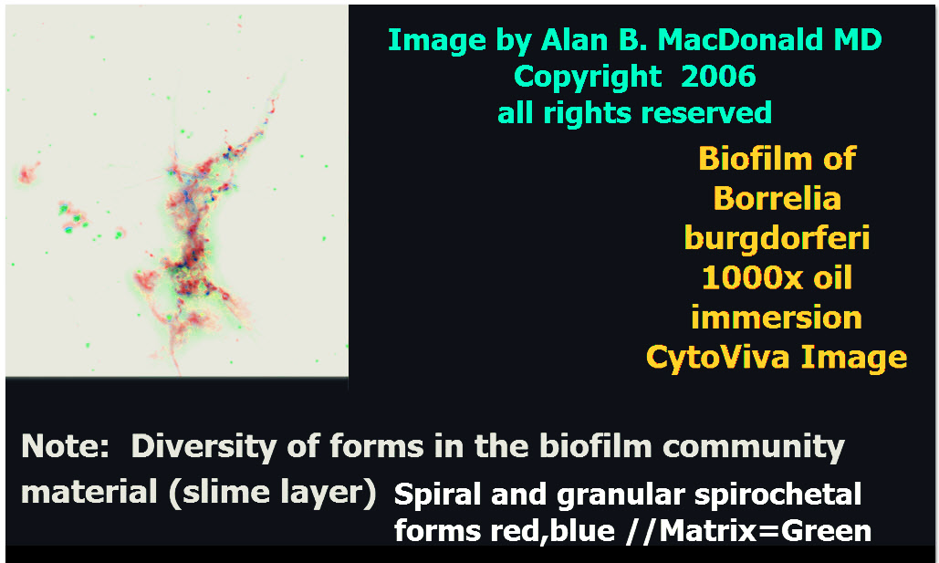

Slide 14
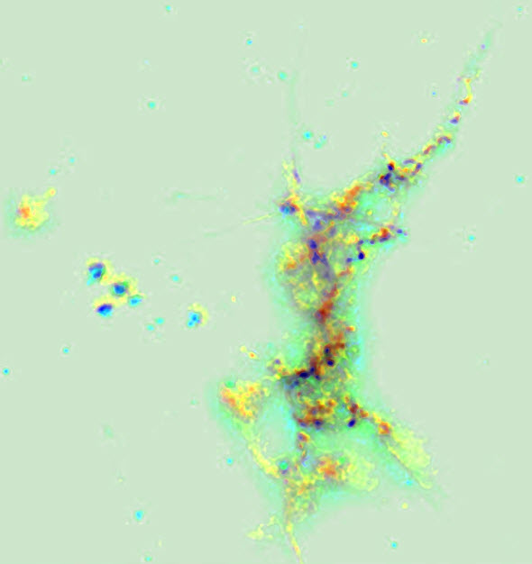

Slide 16
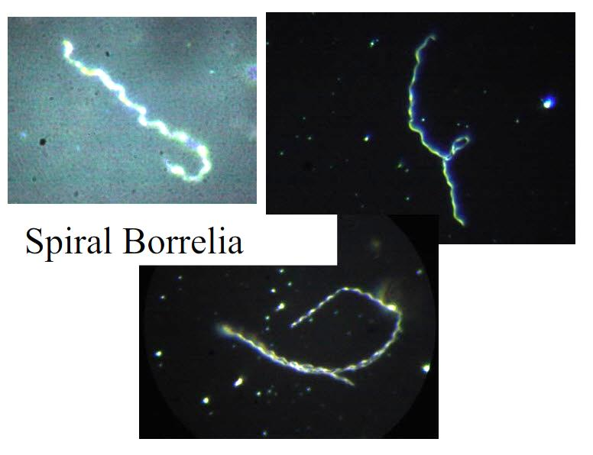

Slide 17
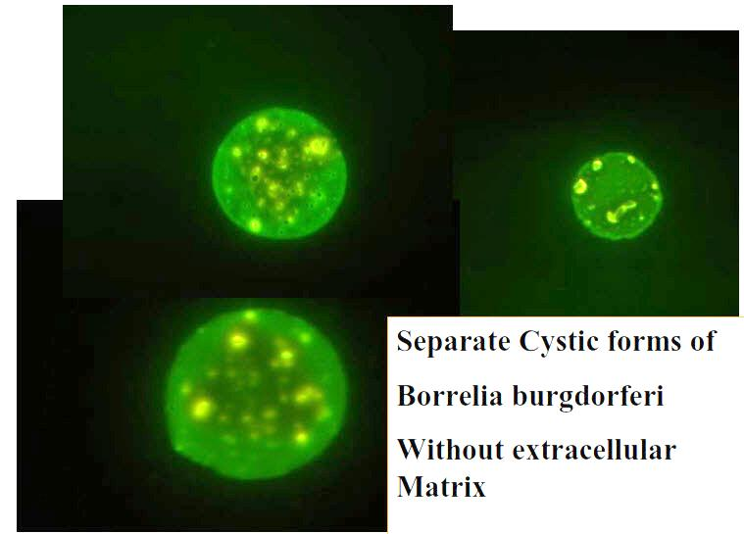

Slide 18
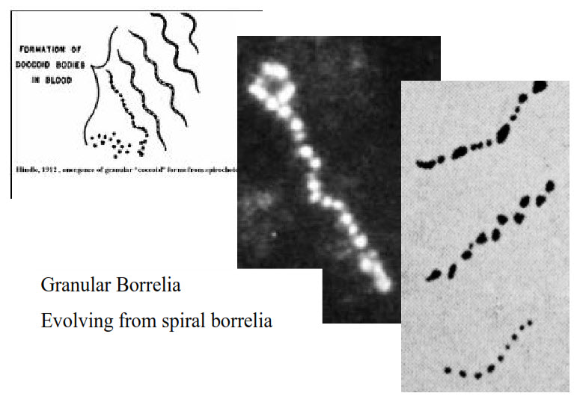

Slide 19
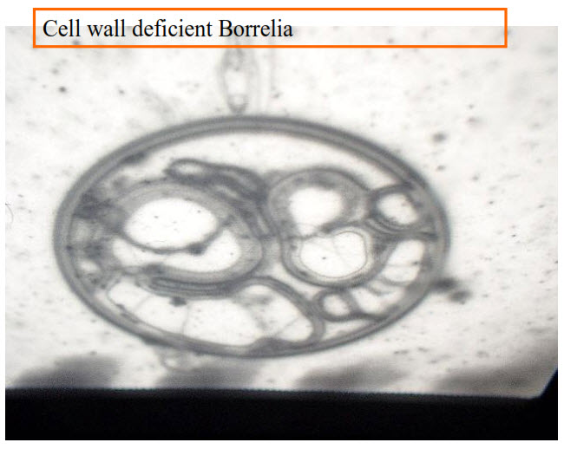

Slide 20
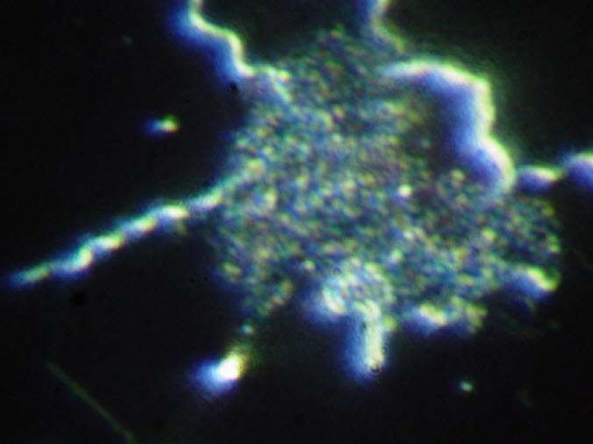

Slide 21
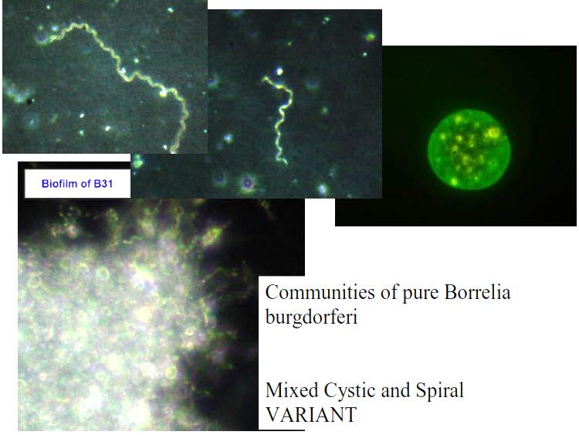

Slide 22
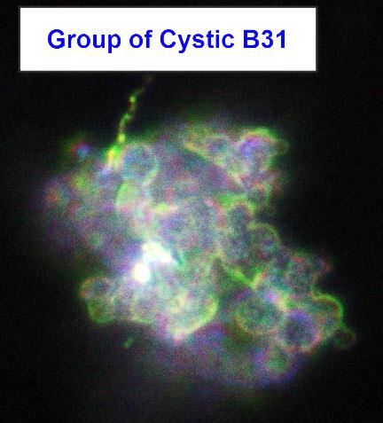

Slide 23
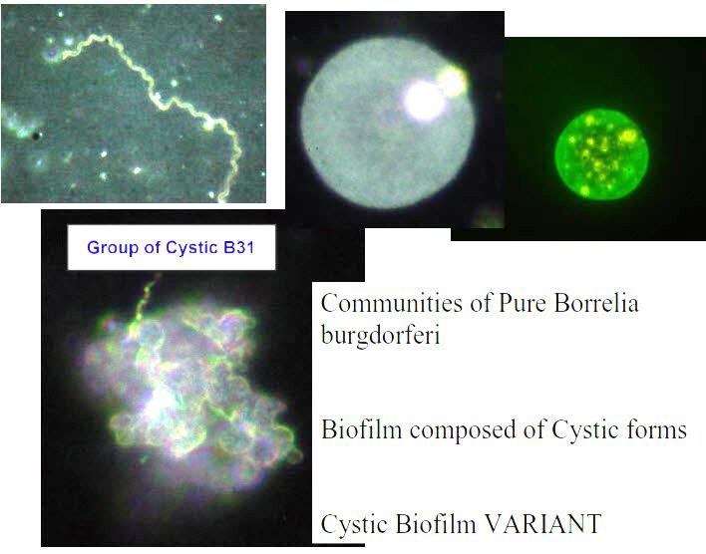

Slide 24
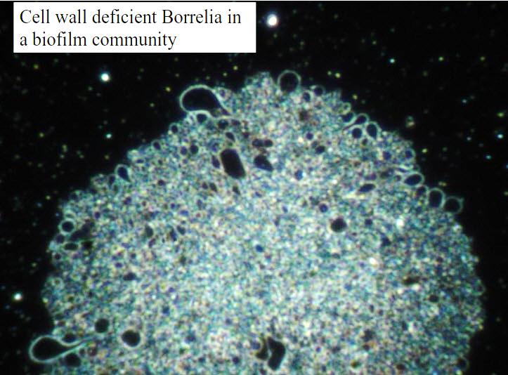

Slide 25
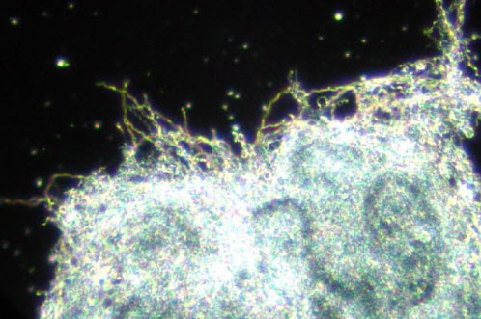

Slide 26
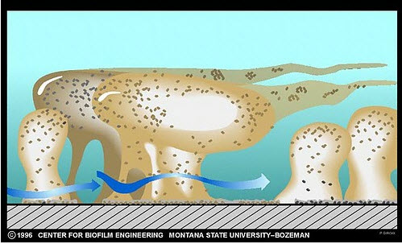
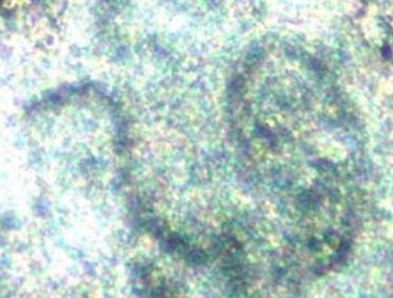
Water channel formation in a biofilm

Slide 27
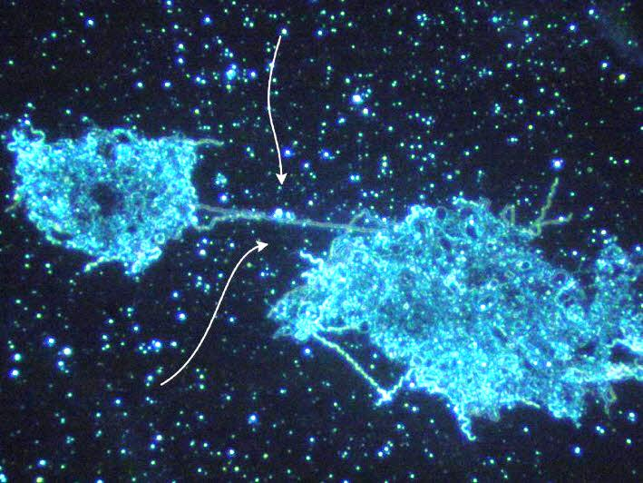

Slide 28
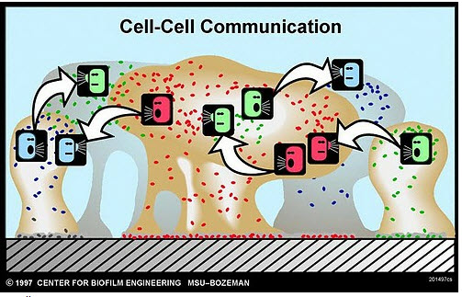
Montana State University
Center for Biofilm Engineering
www.biofilm.montana.edu/resources/images

Slide 29
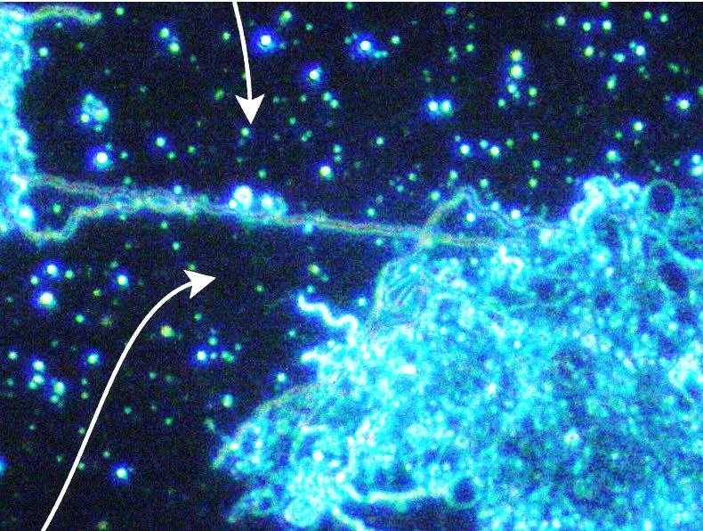

Slide 31
Biofilm Images – copyright (used with permssion for educational purposes only)
Montana State University Center for Bioflm Engineering
Link:
www.biofilm.montana.edu/resources/images

Slide 32
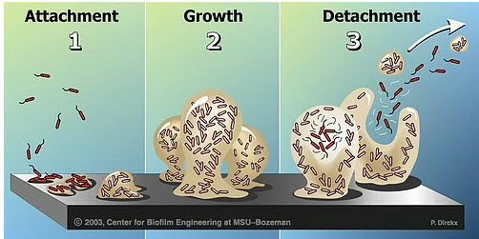
Montana State University
Center for Biofilm Engineering
www.biofilm.montana.edu/resources/images

Slide 33
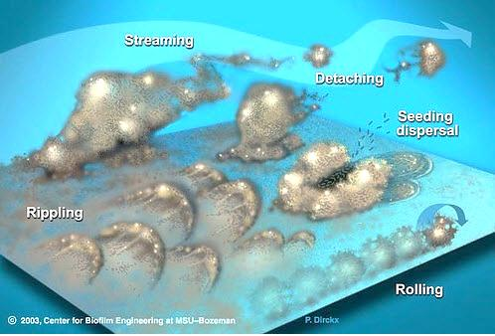
Montana State University
Center for Biofilm Engineering
www.biofilm.montana.edu/resources/images

Slide 34
Montana State University
Center for Biofilm Engineering
www.biofilm.montana.edu/resources/images

Slide 35
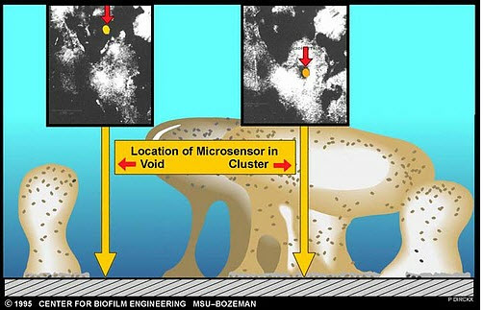
Montana State University
Center for Biofilm Engineering
www.biofilm.montana.edu/resources/images

Slide 36
Montana State University
Center for Biofilm Engineering
www.biofilm.montana.edu/resources/images

Slide 37
Montana State University
Center for Biofilm Engineering
www.biofilm.montana.edu/resources/images

Slide 38
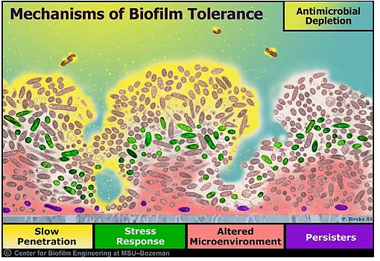
Montana State University
Center for Biofilm Engineering
www.biofilm.montana.edu/resources/images

Slide 39
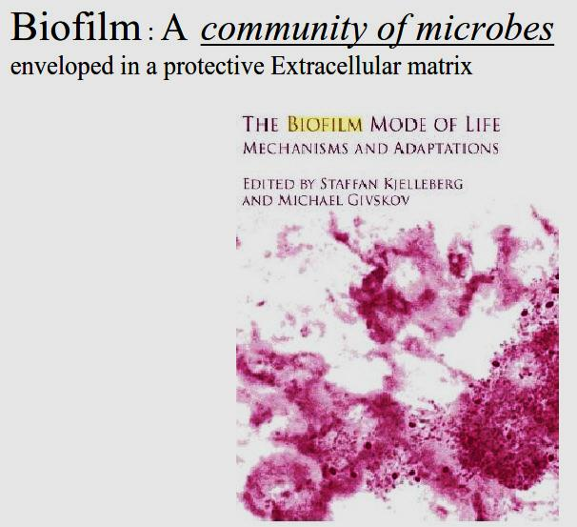

Slide 40
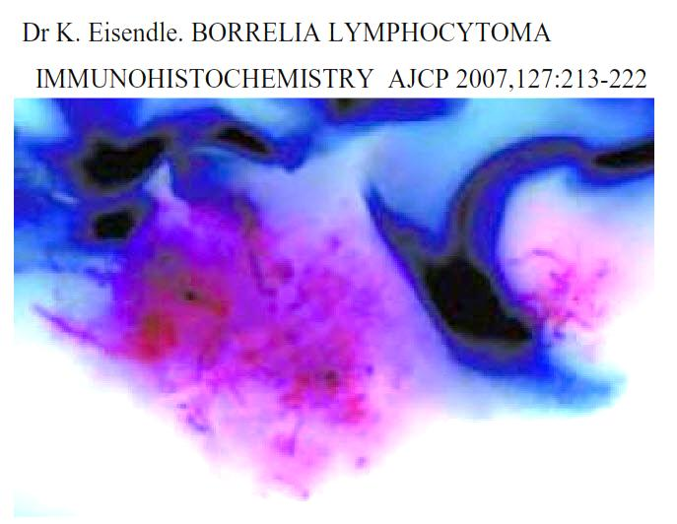

Slide 42
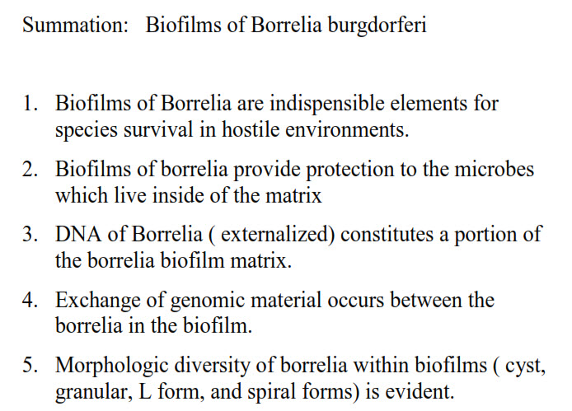

Slide 43
CytoViva
Provides superior and
Unmatched optical
Resolution of Living
Complex Biological systems

Slide 44
Funding for the purchase of the CytoViva Instrument from the following organizations is very gratefully acknowledged Time For Lyme Inc. Lyme Disease Association (LDA)

